Slide 1
Factors that influence soil microbial activities
Microbial Activity
Atmospheric
Soil
Biological
air temperature
air humidity
precipitation
wind speed
soil temperature
soil humidity
soil type
soil pH
soil salinity (or acidity)
soil aeration
soil nutrient
Evapotranspiration
Microbe
Oxygen requirement
Variety
Residual particle
Size
C/N ratio
Protein
Cellulose
Starch(Sugar)
Lignin
Variety
Root
Leaves
Etc.
Anthropogenic
Land use
Land Management
Policy
Law
Financial incentive
Personal motivation

Slide 2
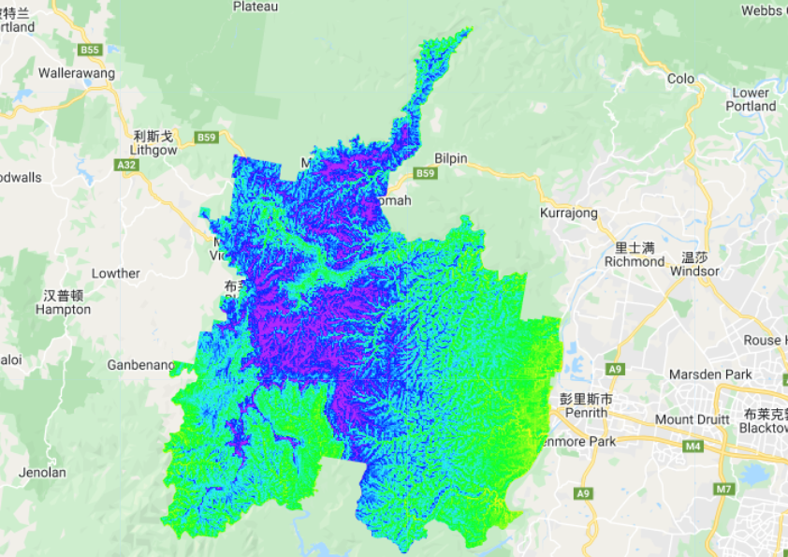
How to use machine learning to understand soil carbon
Case Study:
Blue Mountains Areas
Soil Carbon Storage
Max (Purple): 8% Min (Yellow): 3%

Slide 3
Use machine learning to predict soil carbon
SLGA
Experience
Climate, Environment & Social Topography (Datasets)
Soil Carbon Classification
Dependent Variable (Carbon Storage)
Independent Variables
(Carbon storage Factors)
Flow Chart of Data Processing, Classification and Validation
Combined Training Samples
Training Data (30%)
Training Data (70%)
Accuracy Assessment
Supervised Machine Learning Classification (Random Forest)

Slide 4
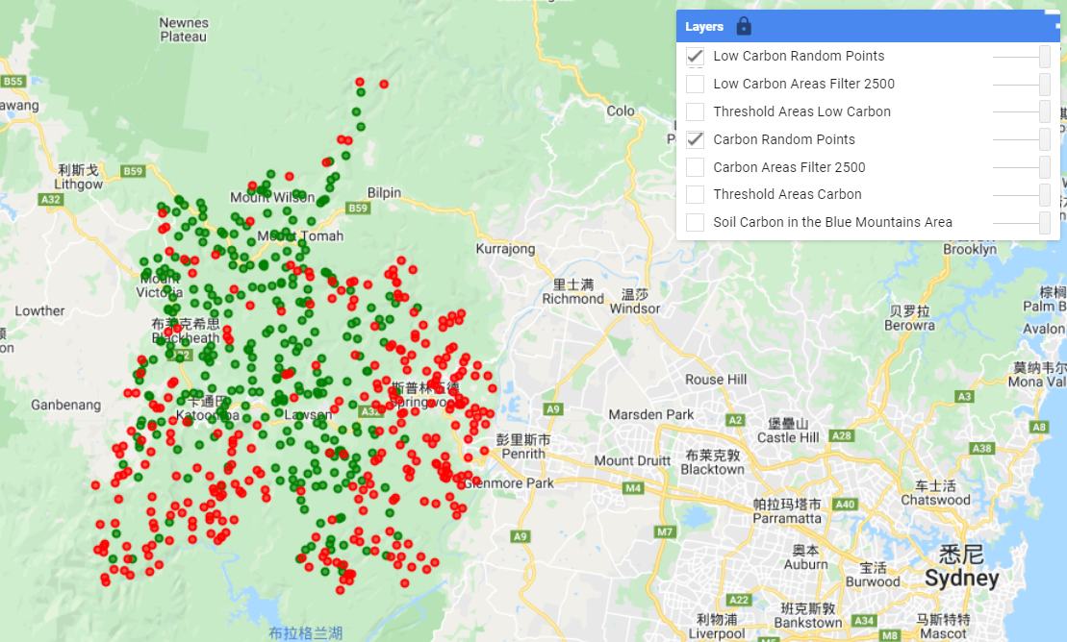
How to use machine learning to predict soil carbon
Training Data
Carbon Storage
Green: Carbon content > 4.5 Red: Carbon content < 4.5

Slide 5
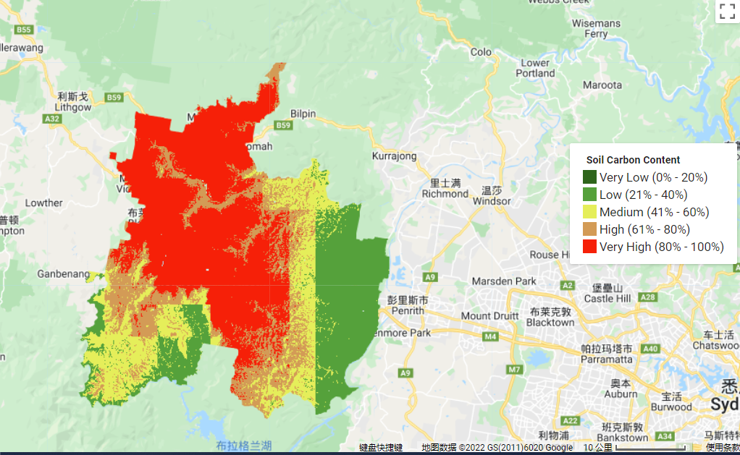
How to use machine learning to predict soil carbon
Classification Result (Random Forest)
 | Low C | High C | Overall Accuracy | Kappa
Low C | 56 | 17 | 0.744 | 0.486
High C | 26 | 69

Slide 6
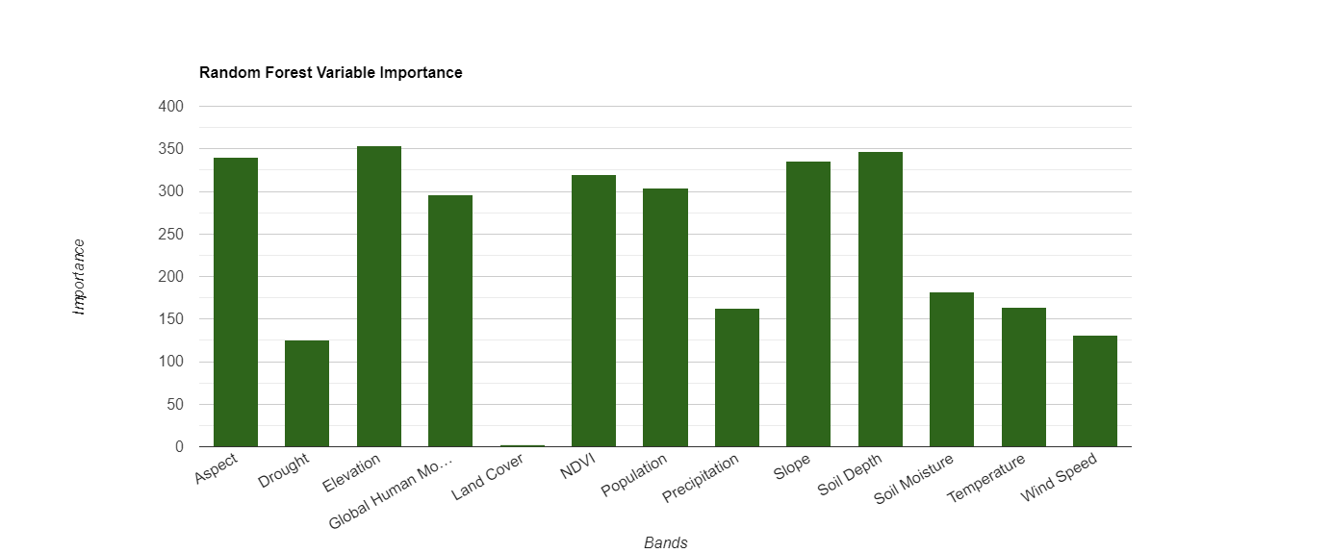

Slide 7

Thank you!

